Slide 1
Suresh.P
HOD / ECE
MEA Engineering College
Perinthalmanna
8086
MICROPROCESSOR

Slide 2
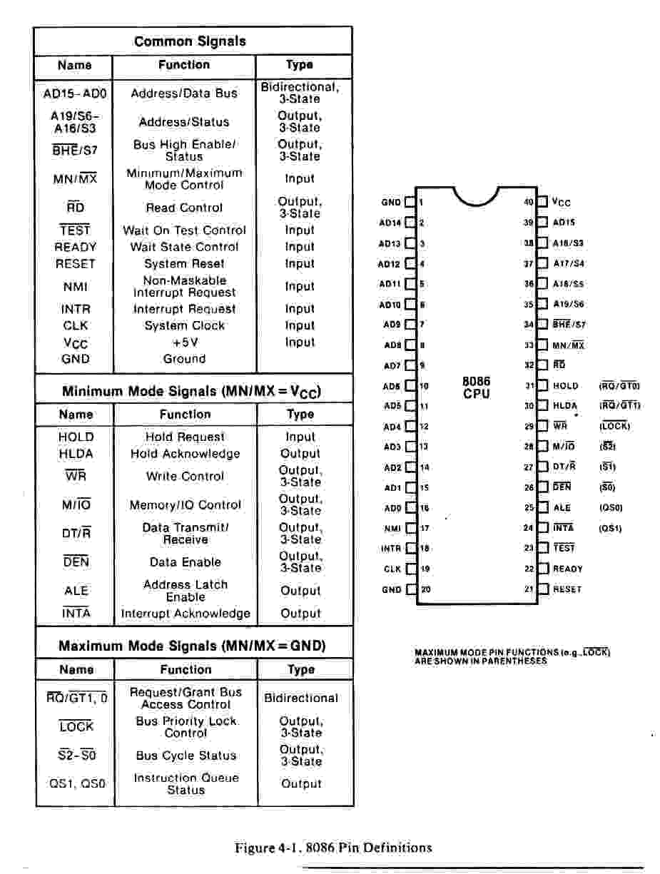
8086 Microprocessor

Slide 3
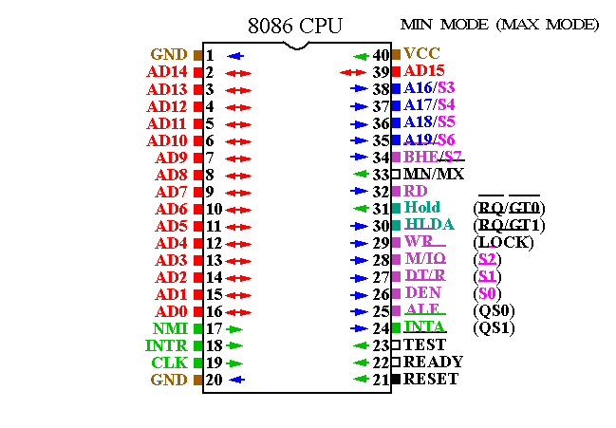

Slide 4
8086 Features
• 16-bit Arithmetic Logic Unit
• 16-bit data bus (8088 has 8-bit data bus)
• 20-bit address bus - 2²⁰ = 1,048,576 = 1 meg
The address refers to a byte in memory. In the 8088, these bytes come in on
the 8-bit data bus. In the 8086, bytes at even addresses come in on the low
half of the data bus (bits 0-7) and bytes at odd addresses come in on the upper
half of the data bus (bits 8-15).
The 8086 can read a 16-bit word at an even address in one operation and at an
odd address in two operations. The 8088 needs two operations in either case.
The least significant byte of a word on an 8086 family microprocessor is at the
lower address.

Slide 5
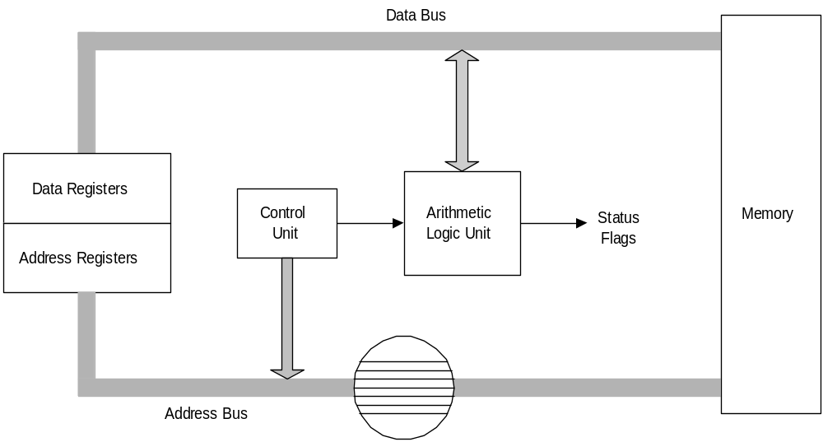
Simplified CPU Design

Slide 6
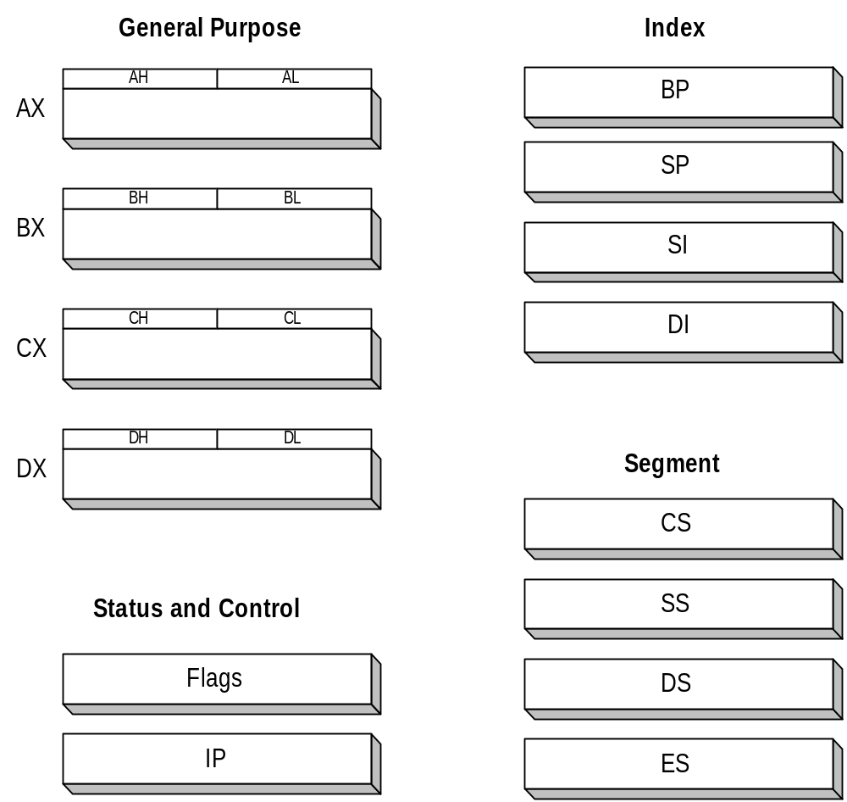
Intel 16-bit Registers

Slide 7
8086 Architecture
  • The 8086 has two parts, the Bus Interface Unit (BIU) and the
  Execution Unit (EU).
  • The BIU fetches instructions, reads and writes data, and computes the
  20-bit address.
  • The EU decodes and executes the instructions using the 16-bit ALU.
  • The BIU contains the following registers:
    IP - the Instruction Pointer
    CS - the Code Segment Register
    DS - the Data Segment Register
    SS - the Stack Segment Register
    ES - the Extra Segment Register
The BIU fetches instructions using the CS and IP, written CS:IP, to contract
the 20-bit address. Data is fetched using a segment register (usually the DS)
and an effective address (EA) computed by the EU depending on the
addressing mode.

Slide 8
The EU contains the following 16-bit registers:
        AX - the Accumulator
        BX - the Base Register
        CX - the Count Register
        DX - the Data Register
        SP - the Stack Pointer \ _{defaults to stack segment}
        BP - the Base Pointer /
        SI - the Source Index Register
        DI - the Destination Register
These are referred to as general-purpose registers, although, as seen by
their names, they often have a special-purpose use for some instructions.
The AX, BX, CX, and DX registers can be considers as two 8-bit registers, a
High byte and a Low byte. This allows byte operations and compatibility with
the previous generation of 8-bit processors, the 8080 and 8085. 8085 source
code could be translated in 8086 code and assembled. The 8-bit registers are:
        AX --> AH,AL
        BX --> BH,BL
        CX --> CH,CL
        DX --> DH,DL

Slide 9
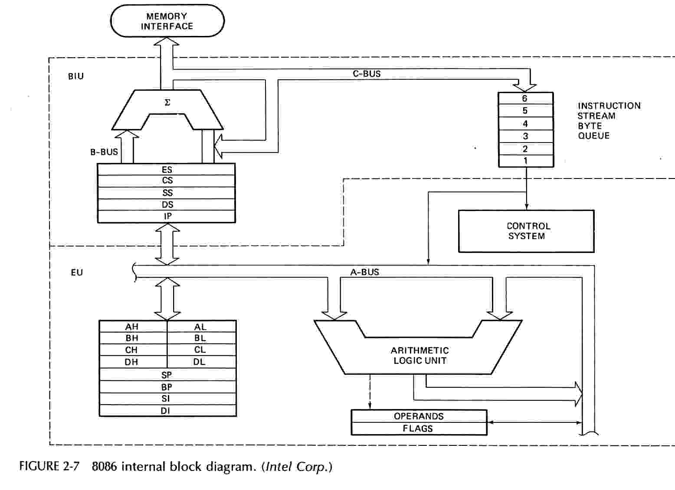

Slide 10
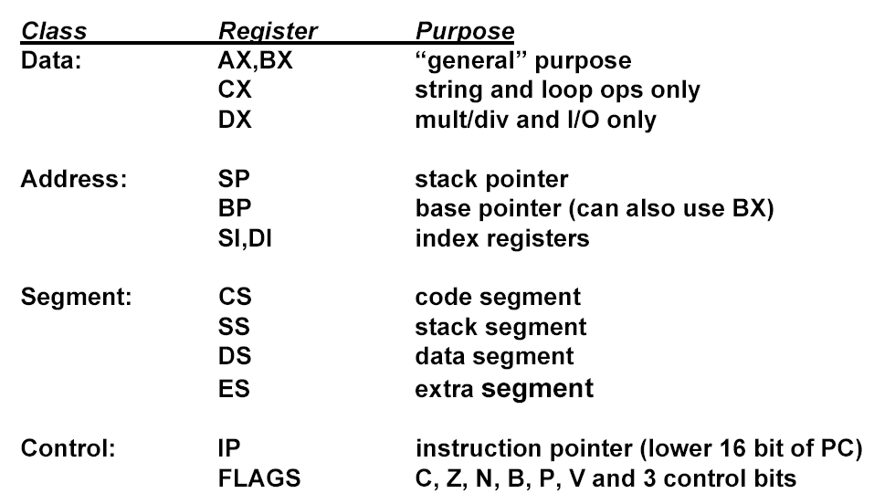
Registers

Slide 11
8086 Programmer’s Model
ES
Extra Segment
_{BIU registers}
_{(20 bit adder)}
CS
Code Segment
SS
Stack Segment
DS
Data Segment
IP
Instruction Pointer
_{EU registers}
AX
AH
AL
Accumulator
BX
BH
BL
Base Register
CX
CH
CL
Count Register
DX
DH
DL
Data Register
SP
Stack Pointer
BP
Base Pointer
SI
Source Index Register
DI
Destination Index Register
FLAGS

Slide 12
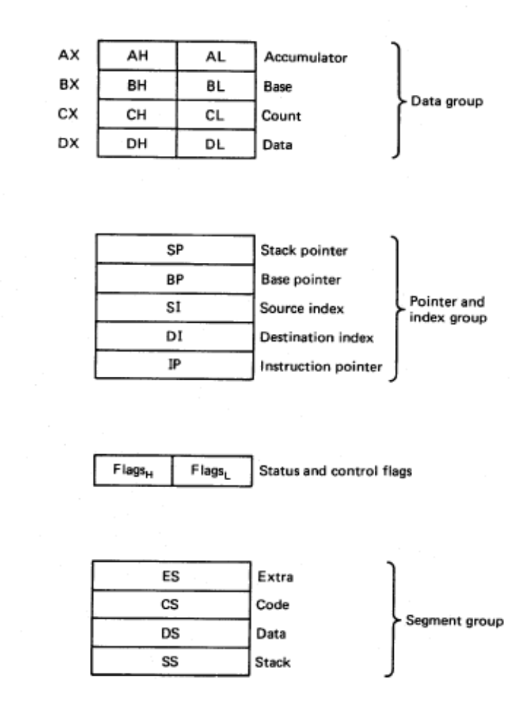
8086/88 internal registers 16 bits (2 bytes each)
AX, BX, CX and DX are two
bytes wide and each byte can
be accessed separately
These registers are used as
memory pointers.
Flags will be discussed later
Segment registers are used
as base address for a segment
in the 1 M byte of memory

Slide 13
The 8086/8088 Microprocessors: Registers
Registers
  Registers are in the CPU and are referred to by specific names
  Data registers
    Hold data for an operation to be performed
    There are 4 data registers (AX, BX, CX, DX)
  Address registers
    Hold the address of an instruction or data element
    Segment registers (CS, DS, ES, SS)
    Pointer registers (SP, BP, IP)
    Index registers (SI, DI)
  Status register
    Keeps the current status of the processor
    On an IBM PC the status register is called the FLAGS register
  In total there are fourteen 16-bit registers in an 8086/8088

Slide 14
Data Registers: AX, BX, CX, DX
Instructions execute faster if the data is in a register
AX, BX, CX, DX are the data registers
Low and High bytes of the data registers can be accessed separately
  AH, BH, CH, DH are the high bytes
  AL, BL, CL, and DL are the low bytes
Data Registers are general purpose registers but they also perform special functions
AX
  Accumulator Register
  Preferred register to use in arithmetic, logic and data transfer instructions because it generates the shortest Machine Language Code
  Must be used in multiplication and division operations
  Must also be used in I/O operations

Slide 15
BX
  Base Register
  Also serves as an address register
CX
  Count register
  Used as a loop counter
  Used in shift and rotate operations
DX
  Data register
  Used in multiplication and division
  Also used in I/O operations

Slide 16
Pointer and Index Registers
Contain the offset addresses of memory locations
Can also be used in arithmetic and other operations
SP: Stack pointer
  Used with SS to access the stack segment
BP: Base Pointer
  Primarily used to access data on the stack
  Can be used to access data in other segments
SI: Source Index register
  is required for some string operations
  When string operations are performed, the SI register points to memory locations in the data segment which is addressed by the DS register. Thus, SI is associated with the DS in string operations.

Slide 17
DI: Destination Index register
  is also required for some string operations.
  When string operations are performed, the DI register points to memory locations in the data segment which is addressed by the ES register. Thus, DI is associated with the ES in string operations.
The SI and the DI registers may also be used to access data stored in arrays

Slide 18
Segment Registers - CS, DS, SS and ES
Are Address registers
Store the memory addresses of instructions and data
Memory Organization
  Each byte in memory has a 20 bit address starting with 0 to 2²⁰-1 or 1 meg of addressable memory
  Addresses are expressed as 5 hex digits from 00000 - FFFFF
  Problem: But 20 bit addresses are TOO BIG to fit in 16 bit registers!
  Solution: Memory Segment
    Block of 64K (65,536) consecutive memory bytes
    A segment number is a 16 bit number
    Segment numbers range from 0000 to FFFF
    Within a segment, a particular memory location is specified with an offset
    An offset also ranges from 0000 to FFFF

Slide 19
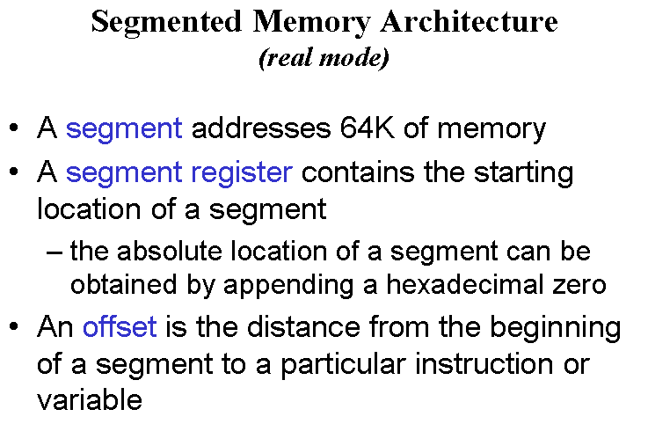

Slide 20

Segmented Memory
Segmented memory addressing: absolute (linear) address is a combination of a 16-bit segment value added to a 16-bit offset
one segment
linear addresses

Slide 21

Intel
Memory Address Generation
The BIU has a dedicated adder for determining physical memory addresses
Offset Value (16 bits)
Segment Register (16 bits)
0 0 0 0
Adder
Physical Address (20 Bits)

Slide 22
Intel
Example Address Calculation
If the data segment starts at location 1000h and a data reference contains the address 29h where is the actual data?
2
9
Offset:
0 0 0 0 0 0 0 0 0 0 1 0 1 0 0 1
Segment:
0 0 0 1 0 0 0 0 0 0 0 0 0 0 0 0
0 0 0 0
Address:
0 0 0 1 0 0 0 0 0 0 0 0 0 0 1 0
1 0 0 1

Slide 23
Segment:Offset Address
Logical Address is specified as segment:offset
Physical address is obtained by shifting the segment address 4 bits to the left and adding the offset address
Thus the physical address of the logical address A4FB:4872 is
      A4FB0
      + 4872
      A9822

Slide 24
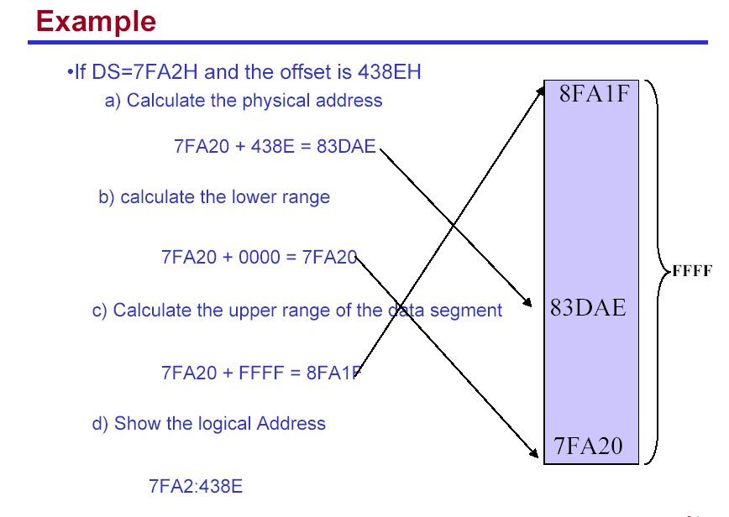

Slide 25
Your turn . . .
What linear address corresponds to the segment/offset address 028F:0030?
028F0 + 0030 = 02920
Always use hexadecimal notation for addresses.

Slide 26
Your turn . . .
What segment addresses correspond to the linear address 28F30h?
Many different segment-offset addresses can produce the linear address 28F30h. For example:
28F0:0030, 28F3:0000, 28B0:0430, . . .

Slide 27
The Code Segment
_{0H}
4000H
CS:
0400H
IP
0056H
4056H
CS:IP = 400:56
Logical Address
Memory
0400
0
Segment Register
Offset
Physical or
Absolute Address
+
0056
04056H
_{0FFFFFH}
The offset is the distance in bytes from the start of the segment.
The offset is given by the IP for the Code Segment.
Instructions are always fetched with using the CS register.
The physical address is also called the absolute address.

Slide 28
The Data Segment
_{0H}
05C00H
DS:
05C0
05C50H
SI
0050
DS:EA
Memory
05C0
0
Segment Register
Offset
Physical Address
+
0050
_{0FFFFFH}
05C50H
Data is usually fetched with respect to the DS register.
The effective address (EA) is the offset.
The EA depends on the addressing mode.

Slide 29
The Stack Segment
_{0H}
0A00
0A000H
SS:
0A100H
SP
0100
SS:SP
Memory
0A00
0
Segment Register
Offset
Physical Address
+
0100
0A100H
_{0FFFFFH}
The offset is given by the SP register.
The stack is always referenced with respect to the stack segment register.
The stack grows toward decreasing memory locations.
The SP points to the last or top item on the stack.
PUSH - pre-decrement the SP
POP - post-increment the SP

Slide 30
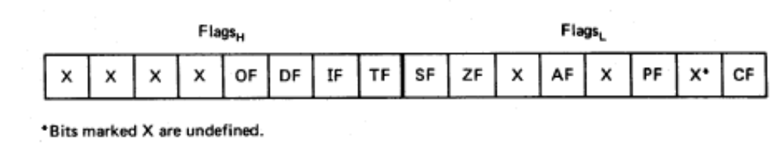
Flags
Carry flag
Overflow
Direction
Parity flag
Interrupt enable
Auxiliary flag
Trap
Zero
Sign
6 are status flags
3 are control flag

Slide 31
Flag Register
Conditional flags:
  They are set according to some results of arithmetic operation. You do not need to alter the value yourself.
Control flags:
  Used to control some operations of the MPU. These flags are to be set by you in order to achieve some specific purposes.
Flag |  |  |  |  | O | D | I | T | S | Z |  | A |  | P |  | C
Bit no. | 15 | 14 | 13 | 12 | 11 | 10 | 9 | 8 | 7 | 6 | 5 | 4 | 3 | 2 | 1 | 0
CF (carry) Contains carry from leftmost bit following arithmetic, also contains last bit from a shift or rotate operation.

Slide 32
Flag Register
OF (overflow) Indicates overflow of the leftmost bit during arithmetic.
DF (direction) Indicates left or right for moving or comparing string data.
IF (interrupt) Indicates whether external interrupts are being processed or ignored.
TF (trap) Permits operation of the processor in single step mode.

Slide 33
SF (sign) Contains the resulting sign of an arithmetic operation (1=negative)
ZF (zero) Indicates when the result of arithmetic or a comparison is zero. (1=yes)
AF (auxiliary carry) Contains carry out of bit 3 into bit 4 for specialized arithmetic.
PF (parity) Indicates the number of 1 bits that result from an operation.

Slide 34
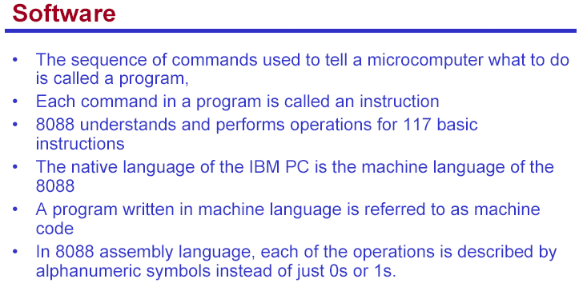
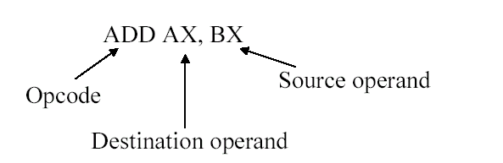

Slide 35
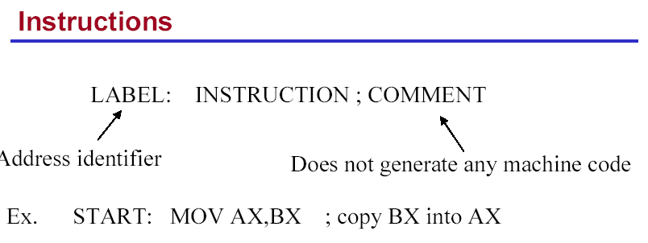

Slide 36
Addressing modes
  Register and immediate modes we have already seen
  MOV AX,1
  MOV BX,AX
  register immediate

Slide 37
3F03 - 80x86 assembler
Typical addressing modes
  Absolute address mode
  MOV AX,[0200]
  value stored in memory location DS:0200

Slide 38
3F03 - 80x86 assembler
Typical addressing modes
  Register indirect
  MOV AX,[BX]
  value stored at address contained in DS:BX

Slide 39
3F03 - 80x86 assembler
Typical addressing modes
  Displacement
  MOV DI,4
  MOV AX,[0200+DI]
  value stored at DS:0204

Slide 40
3F03 - 80x86 assembler
Typical addressing modes
  Indexed
MOV BX,0200
  MOV DI,4
  MOV AX,[BX+DI]
  value stored at DS:0204

Slide 41
3F03 - 80x86 assembler
Typical addressing modes
  Memory indirect
MOV DI,0204
MOV BX,[DI]
  MOV AX,[BX]
  If DS:0204 contains 0256,
  then AX will contain
  whatever is stored at
  DS:0256

Slide 42
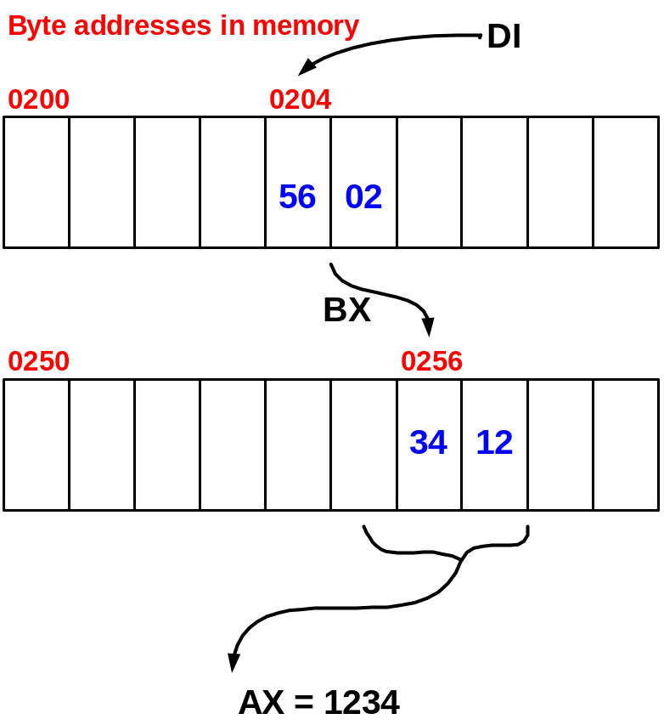
3F03 - 80x86 assembler
Typical addressing modes
  Memory indirect
MOV DI,0204
MOV BX,[DI]
  MOV AX,[BX]
  If DS:0204 contains 0256,
  then AX will contain
  whatever is stored at
  DS:0256

Slide 43
8086 in Maximum Mode
The IBM PC is a maximum mode 8088 system. When an 8086/8088 is used
in the maximum mode (MN/MX pin grounded) it requires the use of an 8288
Bus Controller. The system can support multiple processors on the system
bus by the use of an 8289 Bus Arbiter.
The following signals now come from the 8288: ALE, DT/R’, DEN, and INTA’.
The M/IO’, RD’, and WR’ signals are replaced by:
  MRDC’ - memory read command
  MWTC’ - memory write command
  IORC’ - I/O read command
  IOWC’ - I/O write command
  AMWC’ - Advanced memory write command
  AIOWC’ - Advanced I/O write command
The advanced commands become active earlier in the cycle to give devices
an earlier indication of a write operation.
IV-1

Slide 44
8086 Maximum Mode
When in the maximum mode, the 8086/8088 has 3 status lines that are
connected to the 8288 and provide it with the information it needs to
generate the system bus signals. The information provided by the status
bits is as follows.
S2’ S1’ S0’ operation signal
0 0 0 Interrupt Acknowledge INTA’
0 0 1 Read I/O port IORC’
0 1 0 Write I/O port IOWC’, AIOWC’
0 1 1 Halt none
1 0 0 Instruction Fetch MRDC’
1 0 1 Read Memory MRDC’
1 1 0 Write Memory MWTC’, AMWC’
1 1 1 Passive none
IV-2

Slide 45
Direct Memory Access - DMA
DMA allows data to go between memory and a peripheral, such as a disk
drive, without going through the cpu.
The DMA controller takes over the address bus, data bus, and control bus.
The 8237A DMA Controller is a commonly used device and is in the IBM PC.
Figure 11-4 is a simplified block diagram showing the use of a DMA controller.
For example, to read a disk file the following operations occur.
  1. Send a series of commands to the disk controller to find and read a
  block of data.
  2. When the controller has the first byte of the block, it sends a DMA
  request DREQ to the DMA controller.
  3. If that input of the DMA controller is unmasked, the DMA controller
  sends a hold-request HQR to the cpu.
  4. The cpu responds with a hold-acknowledge HLDA and floats its buses.
  5. The DMA controller then takes control of the buses.
  6. The DMA controller sends out the memory address and DMA
  acknowledge DACK0 to the disk controller.
  7. The DMA controller asserts the MEMW’ and IOR’ lines.
IV-4

Slide 46
Memory
Terminology
Volatile - data is lost when power is turned off.
Nonvolatile - retains data when powered off.
Random Access - all data locations accessed in the same amount of time.
Sequential Access - data accessed in varying amounts of time, e.g., tape.
ROM - Read Only Memory.
RAM - Random Access Memory
By convention, RAM in a PC is really Read/Write Memory and ROM
(EPROM) in a PC, although random access memory, is not referred to
as RAM.
Examples
  VOLATILE NONVOLATILE
Static RAM ROM, PROM, EPROM, EEPROM, FLASH
Dynamic RAM Disk, tape
        Magnetic core, magnetic bubble
IV-6

Slide 47
Interface 8086 to 6116 static RAM
8086
A₀, BHE*
6116 (2K x8)
21
A(11-1)
A(10-0)
A
20
Latch
____
BHE
D(7-0)
D(7-0)
__
R/W
low byte
(even)
ALE
A(19-12)
OE*
D
16
CS*
Addr
Decoder
RAMCS*
__
M/IO
A₀
A(11-1)
A(10-0)
MEM*
D(7-0)
___
WR
D(15-8)
__
R/W
hi byte
(odd)
___
RD
OE*
BHE*
CS*
Wait
State Gen
READY
RLH - Fall 1997

Slide 48
Introduction to
8086 Assembly Language
Programming

Slide 49
What Is Assembly Language
Machine-Specific Programming Language
  one-one correspondence between statements and native machine language
  matches machine instruction set and architecture
IBM-PC Assembly Language
  refers to 8086, 8088, 80186, 80286, 80386, 80486, and Pentium Processors

Slide 50
What Is An Assembler?
Systems Level Program
  translates assembly language source code to machine language
    object file - contains machine instructions, initial data, and information used when loading the program
    listing file - contains a record of the translation process, line numbers, addresses, generated code and data, and a symbol table

Slide 51
Why Learn Assembly Language?
Learn how a processor works
Understand basic computer architecture
Explore the internal representation of data and instructions
Gain insight into hardware concepts
Allows creation of small and efficient programs
Allows programmers to bypass high-level language restrictions
Might be necessary to accomplish certain operations

Slide 52
Data Representation
Binary 0-1
  represents the state of electronic components used in computer systems
Bit - Binary digit
Byte - 8 Bits
  smallest addressable memory location (on the IBM-PC)
Word - 16 Bits
  Each architecture may define its own “wordsize”
Doubleword - 32 Bits
Quadword - 64 Bits
Nybble - 4 Bits

Slide 53
Numbering Systems
Binary - Base 2
  0, 1
Octal - Base 8
  0, 1, 2, … 7
Decimal - Base 10
  0, 1, 2, …, 9
Hexadecimal (Hex)
  0, 1, …, 9, A, B, …, F
Raw Binary format
  All information is coded for internal storage
  Externally, we may choose to express the information in any numeration system, or in a decoded form using other symbols

Slide 54
Decoding a Byte
Raw
  01010000b
Hex
  50h
Octal
  120₈
Decimal
  80d
Machine Instruction
  Push AX
ASCII Character code
  ‘P’
Integer
  80 (eighty)
BCD
  50 (fifty)
Custom code ???

Slide 55
Machine Language
A language of numbers, called the Processor’s Instruction Set
  The set of basic operations a processor can perform
Each instruction is coded as a number
Instructions may be one or more bytes
Every number corresponds to an instruction

Slide 56
Assembly Language vs Machine Language Programming
Machine Language Programming
  Writing a list of numbers representing the bytes of machine instructions to be executed and data constants to be used by the program
Assembly Language Programming
  Using symbolic instructions to represent the raw data that will form the machine language program and initial data constants

Slide 57
Assembly Language Instructions
Mnemonics represent Machine Instructions
  Each mnemonic used represents a single machine instruction
  The assembler performs the translation
Some mnemonics require operands
  Operands provide additional information
    register, constant, address, or variable
Assembler Directives

Slide 58
8086 Instruction - Basic Structure
Label Operator Operand[s] ;Comment
Label - optional alphanumeric string
1st character must be a-z,A-Z,?,@,_,$
Last character must be :
Operator - assembly language instruction
mnemonic: an instruction format for humans
Assembler translates mnemonic into hexadecimal opcode
example: mov is f8h
Operand[s] - 0 to 3 pieces of data required by instruction
Can be several different forms
Delineated by commas
immediate, register name, memory data, memory address
Comment - Extremely useful in assembler language
These fields are separated by White Space (tab, blank, \n, etc.)

Slide 59
8086 Instruction - Example
Label Operator Operand[s] ;Comment
INIT: mov ax, bx ; Copy contents of bx into ax
Label - INIT:
Operator - mov
Operands - ax and bx
Comment - alphanumeric string between ; and \n
Not case sensitive
Unlike other assemblers, destination operand is first
mov is the mnemonic that the assembler translates into an opcode

Slide 60
Assembler Language Segment Types
Stack
  For dynamic data storage
  Source file defines size
  Must have exactly 1
Data
  For static data Storage
  Source file defines size
  Source file defines content (optional)
  Can have 0 or more
Code
  For machine Instructions
  Must have 1 or more

Slide 61
Using MASM Assembler
to get help:
  C:\> masm /h
Can just invoke MASM with no arguments:
  C:\> masm
  Source Filename [.ASM]: hello
  Object Filename [HELLO.OBJ]:
  Source Listing [NUL.LST]:
  Cross Reference [NUL.CRF]:
.ASM - Assembler source file prepared by programmer
.OBJ - Translated source file by assembler
.LST - Listing file, documents “Translation” process
        Errors, Addresses, Symbols, etc
.CRF – Cross reference file

Slide 62
x86 Instruction Set Summary
(Data Transfer)
CBW ;Convert Byte to Word AL → AX
CWD ;Convert Word to Double in AX →DX,AX
IN ;Input
LAHF ;Load AH from Flags
LDS ;Load pointer to DS
LEA ;Load EA to register
LES ;Load pointer to ES
LODS ;Load memory at SI into AX
MOV ;Move
MOVS ;Move memory at SI to DI
OUT ;Output
POP ;Pop
POPF ;Pop Flags
PUSH ;Push
PUSHF ;Push Flags
SAHF ;Store AH into Flags
STOS ;Store AX into memory at DI
XCHG ;Exchange
XLAT ;Translate byte to AL

Slide 63
x86 Instruction Set Summary
(Arithmetic/Logical)
AAA ;ASCII Adjust for Add in AX
AAD ;ASCII Adjust for Divide in AX
AAM ;ASCII Adjust for Multiply in AX
AAS ;ASCII Adjust for Subtract in AX
ADC ;Add with Carry
ADD ;Add
AND ;Logical AND
CMC ;Complement Carry
CMP ;Compare
CMPS ;Compare memory at SI and DI
DAA ;Decimal Adjust for Add in AX
DAS ;Decimal Adjust for Subtract in AX
DEC ;Decrement
DIV ;Divide (unsigned) in AX(,DX)
IDIV ;Divide (signed) in AX(,DX)
MUL ;Multiply (unsigned) in AX(,DX)
IMUL ;Multiply (signed) in AX(,DX)
INC ;Increment

Slide 64
x86 Instruction Set Summary (Arithmetic/Logical Cont.)
NEG ;Negate
NOT ;Logical NOT
OR ;Logical inclusive OR
RCL ;Rotate through Carry Left
RCR ;Rotate through Carry Right
ROL ;Rotate Left
ROR ;Rotate Right
SAR ;Shift Arithmetic Right
SBB ;Subtract with Borrow
SCAS ;Scan memory at DI compared to AX
SHL/SAL ;Shift logical/Arithmetic Left
SHR ;Shift logical Right
SUB ;Subtract
TEST ;AND function to flags
XLAT ;Translate byte to AL
XOR ;Logical Exclusive OR

Slide 65
x86 Instruction Set Summary
(Control/Branch Cont.)
CALL ;Call
CLC ;Clear Carry
CLD ;Clear Direction
CLI ;Clear Interrupt
ESC ;Escape (to external device)
HLT ;Halt
INT ;Interrupt
INTO ;Interrupt on Overflow
IRET ;Interrupt Return
JB/JNAE ;Jump on Below/Not Above or Equal
JBE/JNA ;Jump on Below or Equal/Not Above
JCXZ ;Jump on CX Zero
JE/JZ ;Jump on Equal/Zero
JL/JNGE ;Jump on Less/Not Greater or Equal
JLE/JNG ;Jump on Less or Equal/Not Greater
JMP ;Unconditional Jump
JNB/JAE ;Jump on Not Below/Above or Equal
JNBE/JA ;Jump on Not Below or Equal/Above
JNE/JNZ ;Jump on Not Equal/Not Zero
JNL/JGE ;Jump on Not Less/Greater or Equal

Slide 66
x86 Instruction Set Summary
(Control/Branch)
JNLE/JG ;Jump on Not Less or Equal/Greater
JNO ;Jump on Not Overflow
JNP/JPO ;Jump on Not Parity/Parity Odd
JNS ;Jump on Not Sign
JO ;Jump on Overflow
JP/JPE ;Jump on Parity/Parity Even
JS ;Jump on Sign
LOCK ;Bus Lock prefix
LOOP ;Loop CX times
LOOPNZ/LOOPNE ;Loop while Not Zero/Not Equal
LOOPZ/LOOPE ;Loop while Zero/Equal
NOP ;No Operation (= XCHG AX,AX)
REP/REPNE/REPNZ ;Repeat/Repeat Not Equal/Not Zero
REPE/REPZ ;Repeat Equal/Zero
RET ;Return from call
SEG ;Segment register
STC ;Set Carry
STD ;Set Direction
STI ;Set Interrupt
TEST ;AND function to flags
WAIT ;Wait

Slide 67
Assembler Directives
end label end of program, label is entry point
proc far|near begin a procedure; far, near keywords specify if procedure in different code segment (far), or same code segment (near)
endp end of procedure
page set a page format for the listing file
title title of the listing file
.code mark start of code segment
.data mark start of data segment
.stack set size of stack segment

Slide 68
Assembler Directives
db define byte
dw define word (2 bytes)
dd define double word (4 bytes)
dq define quadword (8 bytes)
dt define tenbytes
equ equate, assign numeric expression to a name
Examples:
db 100 dup (?) define 100 bytes, with no initial values for bytes
db “Hello” define 5 bytes, ASCII equivalent of “Hello”.
maxint equ 32767
count equ 10 * 20 ; calculate a value (200)

Slide 69
Program Example
;;;;;;;;;;;;;;;;;;;;;;;;;;;;;;;;;;;;;;;;;;;;;;;;;;;;;;;;;;;;;;;;;;;;;
; ;
; This is an example program. It prints the ;
; character string "Hello World" to the DOS standard output ;
; using the DOS service interrupt, function 9. ;
; ;
;;;;;;;;;;;;;;;;;;;;;;;;;;;;;;;;;;;;;;;;;;;;;;;;;;;;;;;;;;;;;;;;;;;;;
hellostk SEGMENT BYTE STACK 'STACK' ;Define the stack segment
DB 100h DUP(?) ;Set maximum stack size to 256 bytes (100h)
hellostk ENDS
hellodat SEGMENT BYTE 'DATA' ;Define the data segment
dos_print EQU 9 ;define a constant via EQU
strng DB 'Hello World',13,10,'$' ;Define the character string
hellodat ENDS
hellocod SEGMENT BYTE 'CODE' ;Define the Code segment
START: mov ax, SEG hellodat ;ax <-- data segment start address
mov ds, ax ;ds <-- initialize data segment register
mov ah, dos_print ;ah <-- 9 DOS 21h string function
mov dx,OFFSET strng ;dx <-- beginning of string
int 21h ;DOS service interrupt
mov ax, 4c00h ;ax <-- 4c DOS 21h program halt function
int 21h ;DOS service interrupt
hellocod ENDS
END START ; ‘END label’ defines program entry

Slide 70
Another Way to define Segments
;;;;;;;;;;;;;;;;;;;;;;;;;;;;;;;;;;;;;;;;;;;;;;;;;;;;;;;;;;;;;;;;;;;;;
; Use 'assume' directive to define segment types ;
; ;
;;;;;;;;;;;;;;;;;;;;;;;;;;;;;;;;;;;;;;;;;;;;;;;;;;;;;;;;;;;;;;;;;;;;;
hellostk SEGMENT ;Define a segment
DB 100h DUP(?)
hellostk ENDS
hellodat SEGMENT ;define a segment
dos_print EQU 9 ;define a constant
strng DB 'Hello World',13,10,'$' ;Define the character string
hellodat ENDS
hellocod SEGMENT ;define a segment
assume cs:hellocod, ds:hellodat, ss: hellostk
START: mov ax, hellodat ;ax <-- data segment start address
mov ds, ax ;ds <-- initialize data segment register
mov ah, dos_print ;ah <-- 9 DOS 21h string function
mov dx,OFFSET strng ;dx <-- beginning of string
int 21h ;DOS service interrupt
mov ax, 4c00h ;ax <-- 4c DOS 21h program halt function
int 21h ;DOS service interrupt
hellocod ENDS
END START

Slide 71
Yet another way to define Segs
;;;;;;;;;;;;;;;;;;;;;;;;;;;;;;;;;;;;;;;;;;;;;;;;;;;;;;;;;;;;;;;;;;;;;
; Use .stack,.data,.code directives to define segment types ;
; ;
;;;;;;;;;;;;;;;;;;;;;;;;;;;;;;;;;;;;;;;;;;;;;;;;;;;;;;;;;;;;;;;;;;;;;
.stack 100h ; reserve 256 bytes of stack space
.data
dos_print EQU 9 ;define a constant
strng DB 'Hello World',13,10,'$' ;Define the character string
.code
START: mov ax, SEG strng ;ax <-- data segment start address
mov ds, ax ;ds <-- initialize data segment register
mov ah, dos_print ;ah <-- 9 DOS 21h string function
mov dx,OFFSET strng ;dx <-- beginning of string
int 21h ;DOS service interrupt
mov ax, 4c00h ;ax <-- 4c DOS 21h program halt function
int 21h ;DOS service interrupt
END START

Slide 72
Program Statements
name operation operand(s) comment
Operation is a predefined or reserved word
  mnemonic - symbolic operation code
  directive - pseudo-operation code
Space or tab separates initial fields
Comments begin with semicolon
Most assemblers are not case sensitive

Slide 73
Program Data and Storage
Pseudo-ops to define data or reserve storage
  DB - byte(s)
  DW - word(s)
  DD - doubleword(s)
  DQ - quadword(s)
  DT - tenbyte(s)
These directives require one or more operands
  define memory contents
  specify amount of storage to reserve for run-time data

Slide 74
Defining Data
Numeric data values
  100 - decimal
  100B - binary
  100H - hexadecimal
  '100' - ASCII
  "100" - ASCII
Use the appropriate DEFINE directive (byte, word, etc.)
A list of values may be used - the following creates 4 consecutive words
  DW 40CH,10B,-13,0
A ? represents an uninitialized storage location
  DB 255,?,-128,'X'

Slide 75
Naming Storage Locations
Names can be associated with storage locations
  ANum DB -4
  DW 17
  ONE
  UNO DW 1
  X DD ?
These names are called variables
ANum refers to a byte storage location, initialized to FCh
The next word has no associated name
ONE and UNO refer to the same word
X is an unitialized doubleword

Slide 76
Arrays
Any consecutive storage locations of the same size can be called an array
  X DW 40CH,10B,-13,0
  Y DB 'This is an array'
  Z DD -109236, FFFFFFFFH, -1, 100B
Components of X are at X, X+2, X+4, X+8
Components of Y are at Y, Y+1, …, Y+15
Components of Z are at Z, Z+4, Z+8, Z+12

Slide 77
DUP
Allows a sequence of storage locations to be defined or reserved
Only used as an operand of a define directive
DB 40 DUP (?)
DW 10h DUP (0)
DB 3 dup ("ABC")

Slide 78
Word Storage
Word, doubleword, and quadword data are stored in reverse byte order (in memory)
Directive Bytes in Storage
DW 256 00 01
DD 1234567H 67 45 23 01
DQ 10 0A 00 00 00 00 00 00 00
X DW 35DAh DA 35
  Low byte of X is at X, high byte of X is at X+1

Slide 79
Named Constants
Symbolic names associated with storage locations represent addresses
Named constants are symbols created to represent specific values determined by an expression
Named constants can be numeric or string
Some named constants can be redefined
No storage is allocated for these values

Slide 80
Equal Sign Directive
name = expression
  expression must be numeric
  these symbols may be redefined at any time
  maxint = 7FFFh
  count = 1
  DW count
  count = count * 2
  DW count

Slide 81
EQU Directive
name EQU expression
  expression can be string or numeric
  Use < and > to specify a string EQU
  these symbols cannot be redefined later in the program
  sample EQU 7Fh
  aString EQU <1.234>
  message EQU <This is a message>

Slide 82
Data Transfer Instructions
MOV target, source
  reg, reg
  mem, reg
  reg, mem
  mem, immed
  reg, immed
Sizes of both operands must be the same
reg can be any non-segment register except IP cannot be the target register
MOV's between a segment register and memory or a 16-bit register are possible

Slide 83
Sample MOV Instructions
b db 4Fh
w dw 2048
mov bl,dh
mov ax,w
mov ch,b
mov al,255
mov w,-100
mov b,0
When a variable is created with a define directive, it is assigned a default size attribute (byte, word, etc)
You can assign a size attribute using LABEL
  LoByte LABEL BYTE
  aWord DW 97F2h

Slide 84
Addresses with Displacements
b db 4Fh, 20h, 3Ch
w dw 2048, -100, 0
mov bx, w+2
mov b+1, ah
mov ah, b+5
mov dx, w-3
Type checking is still in effect
The assembler computes an address based on the expression
NOTE: These are address computations done at assembly time
MOV ax, b-1
will not subtract 1 from the value stored at b

Slide 85
eXCHanGe
XCHG target, source
  reg, reg
  reg, mem
  mem, reg
MOV and XCHG cannot perform memory to memory moves
This provides an efficient means to swap the operands
  No temporary storage is needed
  Sorting often requires this type of operation
  This works only with the general registers

Slide 86
Arithmetic Instructions
ADD dest, source
SUB dest, source
INC dest
DEC dest
NEG dest
Operands must be of the same size
source can be a general register, memory location, or constant
dest can be a register or memory location
  except operands cannot both be memory

Slide 87
Program Segment Structure
Data Segments
  Storage for variables
  Variable addresses are computed as offsets from start of this segment
Code Segment
  contains executable instructions
Stack Segment
  used to set aside storage for the stack
  Stack addresses are computed as offsets into this segment
Segment directives
  .data
  .code
  .stack size

Slide 88
Memory Models
.Model memory_model
  tiny: code+data <= 64K (.com program)
  small: code<=64K, data<=64K, one of each
  medium: data<=64K, one data segment
  compact: code<=64K, one code segment
  large: multiple code and data segments
  huge: allows individual arrays to exceed 64K
  flat: no segments, 32-bit addresses, protected mode only (80386 and higher)

Slide 89
Program Skeleton
.model small
.stack 100H
.data
;declarations
.code
main proc
;code
main endp
;other procs
end main
Select a memory model
Define the stack size
Declare variables
Write code
  organize into procedures
Mark the end of the source file
  optionally, define the entry point

